Slide 1
Weekly Review

Slide 2
Duolingo
Alex Plitt, 150 days

Slide 3
This Week
CIW Certification is extended
I realized it requires you to get an 80% on the pre-test, which most of us cannot yet
We need this for future lessons
At some point I will be fielding Junior’s questions about their projects, and they will be presented to me
We will be studying for the NOCTI performance test heavily until the end of the month

Slide 4
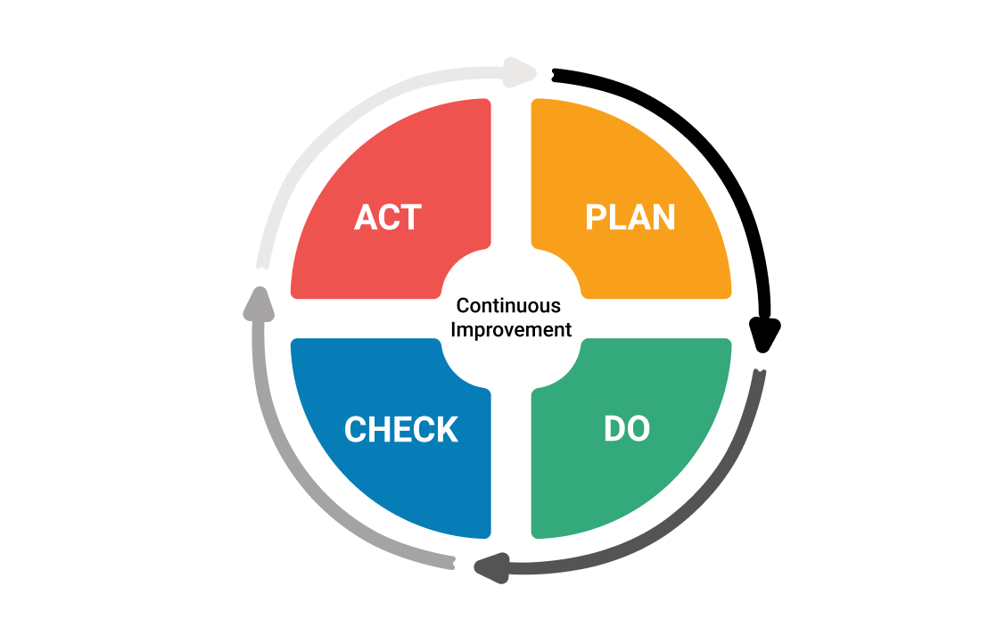
Continuous Improvement

